Slide 1
Ethical considerations in AI and mathematical modelling for public health decision making
Cc by 4.0
Raphael sonabend
Notes:
Whilst I'm mainly here to talk about AI, will also be talking about mathematical modelling.
Fine line between what is/n't AI.
Focus today on public health decision making and answer the question: when is it ethical to use AI?

Slide 2
Abstract
COVID-19 placed clinicians, epidemiologists, and data scientists in the spotlight and allowed fast uptake of machine learning and mathematical models, including policy being made based on these models. Increasing interest in statistics and software is a great step forward for our community, but is it coming at a cost to trustworthiness and model accuracy? Are we getting too focused in application at the expense of the theory? Or are we too interested in theory and losing sight of the purpose of our research?
In this talk we will take a critical look at AI and mathematical modelling to consider explainability and sustainability of AI with applications in healthcare and policy making. We’ll dive into technical topics such as survival analysis and scoring rules, as well as bigger picture ideas such as open source and community building. Case studies from COVID-19 modelling will be used throughout the talk to exemplify everything we cover.

Slide 3

About Me
BSc Statistics, UCL
PhD Statistics, UCL
Postdoctoral Fellow, Department of Computer Science, TU Kaiserslautern
Honorary Researcher, Data Science and its Applications, DFKI
Research Associate, Department of Engineering, Cambridge University
Visiting Researcher, Department of Infectious Disease Epidemiology, Imperial College London
Technology Manager, Data for Science and Health, The Wellcome Trust

Slide 4

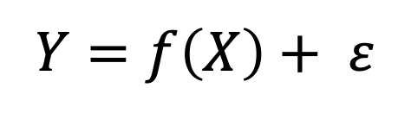


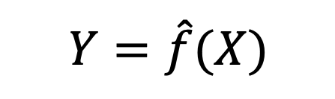
$$Y=f\left(X\right)+ ε$$
$$Y=\hat{f}(X)$$
$$\hat{f}(Z_{1})$$
$$\hat{f}(Z_{ν})$$
Notes:
Usually, ML researchers are primarily interested in the red arrow as this is where ML is involved: model training and learning from data
But today we’re mainly interested in the blue dotted and orange dashed arrows.
How well does the model apply to new data (Z_1) which may be a holdout or CV dataset. And how well does it generalise to new data over time (Z...).
In this talk we are going to be discussing these arrows and examining the black-box across 3 areas.

Slide 5
Applications
Sustainability
Explainability
Ethical AI
Notes:
* We will ask, and try to answer, the following Qs:
1. Is the model fit for purpose and applicable in the real-world?
2. Is the model explainable?
3. Is the model sustainable? Can it be re-purposed and reused again and again?
* Hopefully you will see how this model fits a real-world pipeline: first we consider the required applications and utilise theory, then we train our model and consider if it's ready for deployment by: i) validating the model and explaining how it works; then ii) considering if it is sustainable and useful in the long-term.

Slide 6

Ethical ai
Notes:
So what do we mean by Ethical AI?
Broad field covering all decisions made in building, deploying, and sustaining AI
In this talk we are primarily concerned with the deployment of AI and the generalisation to new data.
We will tackle the question: when is it ethical to utilise ML to make decisions in public health?
Or the question I'll keep coming back to: would you trust decisions made for you or a relative based on a model?

Slide 7
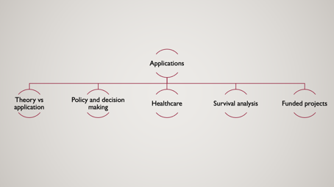
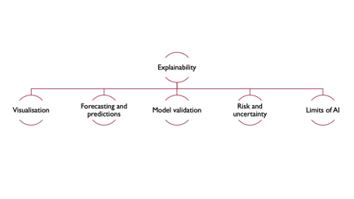
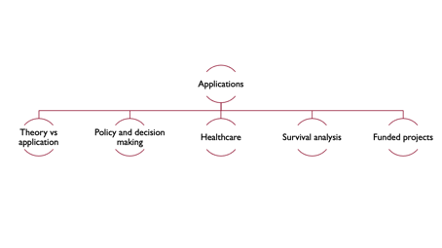
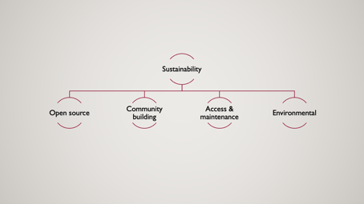
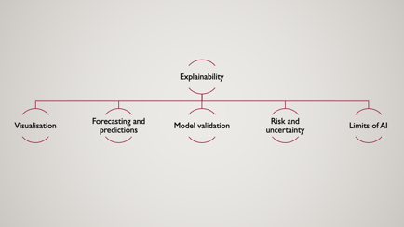
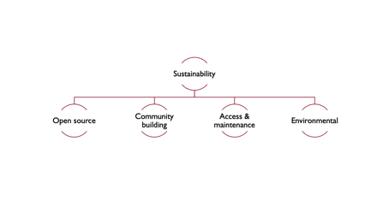
Notes:
Let's get into the talk!
First covering applications: where might ML be deployed and how?
Then Explainability: can we explain what a model is doing and how?
Then Sustainability: can we ensure the model is sustainable?
Each asks an ethical Q that we will try and answer.

Slide 8
Healthcare
Survival analysis
Policy and decision making
Applications
Theory vs application
Funded projects
Notes:
Begin with applications.
These are the topics we'll be covering.
I’ll give a quick overview to what I mean by Applications and then I’ll give an overview to each topic.

Slide 9
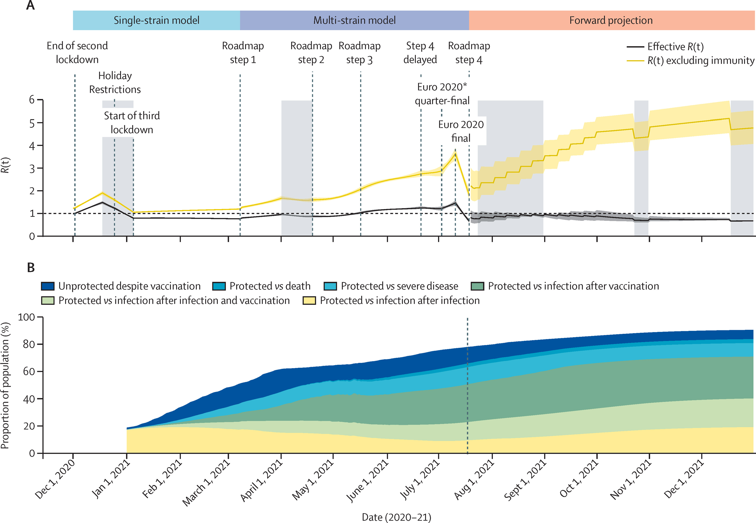
applications
Figure from Sonabend et al. (2021). Non-pharmaceutical interventions, vaccination, and the SARS-CoV-2 delta variant in England: a mathematical modelling study. The Lancet. https://doi.org/https://doi.org/10.1016/S0140-6736(21)02276-5
Notes:
In PH decisions, many areas to consider. Today focus on individual healthcare, risk prediction models, and mathematical models. I'll use my experience in C19 for examples so here's background
This image shows a fig from a retrospective study to understand if our C19 modelling was useful for UK gov. Later we’ll come back to how to interpret this graph.
3 UK lockdowns. March 2020, Nov 2020, Jan 2021. We modelled when and how to lift each stage of the 3rd lockdown to create a ‘roadmap’ out of lockdown.
Context: Eng had 18.8M cases & 178K deaths. Ger had 26.5M cases and 139K deaths.

Slide 10
Applications
Theory vs application
Policy and decision making
Healthcare
Survival analysis
Funded projects
We need both!
Dealing with politics and research
Ethical considerations in healthcare
Where theory meets application
What research is being funded?
Notes:
Despite this section being about Application, we will start with Theory & why we need both.
Then we will discuss the bridge between theory and application in context of policy and PH decisions.
In the context of healthcare decision making we will consider key ethical considerations
Then put together ethical considerations with need for interest in theory & application to discuss survival
Finally I will show you how funders are interested in funding theory in order to boost application

Slide 11
Theory VS. Application
Too few theorists
Code is excessive and duplicative
Poor and unheard feedback between researchers and domain experts/policymakers
Cutting-edge research not used in practice
Research is siloed
Too many theorists
Low code quality & research is inaccessible
Poor and undirected feedback between researchers and domain experts/policymakers
Cutting-edge research not used in practice
Research is duplicative and competitive
Notes:
Crucial for modern-day academics to be engaged with application and not just theory.
Theory: not enough theorists -> research is disparate & hard to link, too much focus on code leads to unnecessary repetition and competition, policy makers are unable to interact with theorists well-enough and ultimately cutting-edge research not used in practice
Application side: too many theorists means code quality is poor due to lack of interest in translating work, this also has knock-one effect of research being inaccessible to the majority of people. Competition in research leads to competition and makes it difficult for policymakers to identify researchers to provide feedback about requirements.& interests. Ultimately again this leads to a lack of cutting-edge research in practice

Slide 12
Theory AND Application
By taking an early interest in translating your own theory into code you are actively contributing to high-quality academic research.
Not translating your own work into code may lead to someone else doing it poorly.
Research software engineers and increasing open-source interest from industry is a promising sign of future, collaborative progress.
Notes:
Everyone in this room can help & there are promising signs that researchers are increasingly interested in a mix between theory & application (e.g. RSEs)
1) Translate your own work into code to help build your network, academic profile, and ensure people can use your research
2) Not doing this may lead to someone else doing it poorly or miscrediting you
3) Promising signs that future is more collaborative and mixed theory/application as RSEs and other positions have higher profiles
It’s important to view these as two parts of one field and not distinct. To see where these meet, consider policy & decision making.

Slide 13
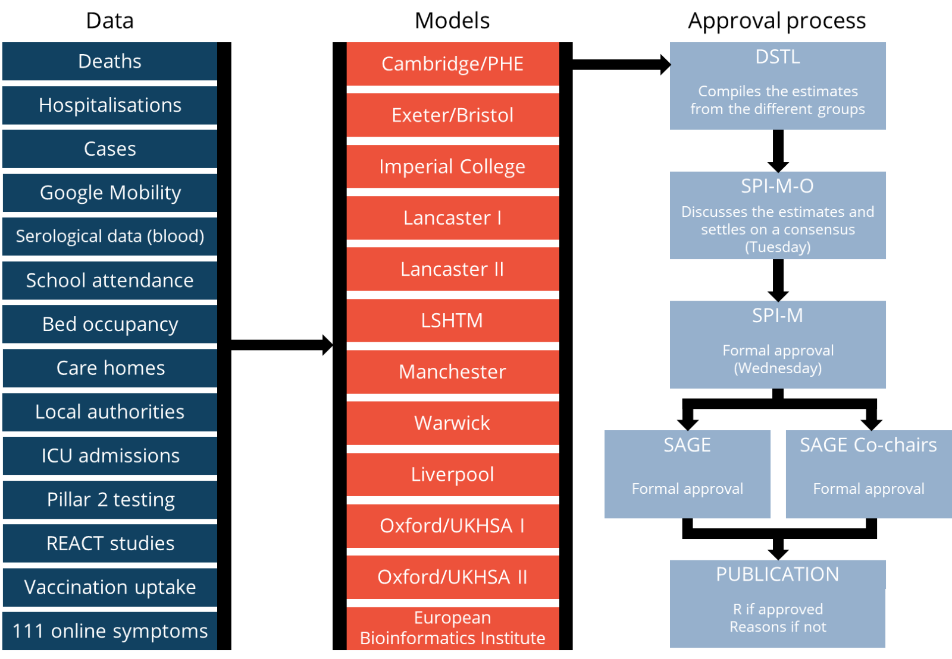
Policy and decision making
Research may influence policy directly or indirectly. The effects of research on policy may be instantaneous or only understood retrospectively
Keep a healthy barrier between research and politics but don’t underestimate your research.
Be proud when research does make a difference.
Notes:
How modelling can make a difference with applications in COVID. Liability and public understanding.
C19 demonstrated how quickly research can be released by embracing preprints, this meant some research directly influencing policy (e.g. via SAGE) or more indirectly (e.g. understanding how number of occupied beds affects mortality). Both equally important and therefore essential to recognise how politically sensitive and citizen-centred data may be picked up and utilised over time.
Must consider liability & public understanding. Researchers not liable for the actions of policymakers. Nor are they responsible for public understanding. However, we must recognise that how we phrase research can have a direct effect…
We had 6 papers published for SAGE. Only one made a difference, delaying one step of unlocking by 3 weeks. In this case there was a lot of debate in how best to phrase key findings.
Researchers are often shielded from decisions made by policy makers, however behind these lies many ethical Qs, especially in healthcare.

Slide 14
Ethical considerations in Healthcare
Can you justify ML over more interpretable methods?
Would you trust an algorithm over a clinician?
Is your model fair and unbiased? Are there any disadvantaged groups?
Is AI masking uncertainty? How do we communicate uncertainty and model error?
Are data collection methods ethical? What about dissemination?
Was the model trained on a representative dataset?
Is the data underlying the model ethically stored and protected?
Has the model been sufficiently validated over time to ensure it is still relevant?
Does a clinician understand a model sufficiently? Does that model generalize to any patient or even hospital?
Is the theory underlying the chosen model correct?
Have sufficient alternative models been considered?
Notes:
We’ve already talked about theory and about how a model may be used in policy & decision making, which means now is a good time to stop and stand back before moving on.
Don't answer these Qs but pause to think about them. So much potential room for bias and ethical issues that it could be made impossible to deploy any AI.
Having an awareness for these problems, and demonstrating good knowledge of the theory behind them and how they were dealt with in practice, is sufficient for deployment.
When talking about ethics and policy and other big Qs, there is a healthy trade-off between worrying too much and not enough.
With that in mind, we’re now going to take a deep dive into some theory to demonstrate its direct importance in applications.

Slide 15
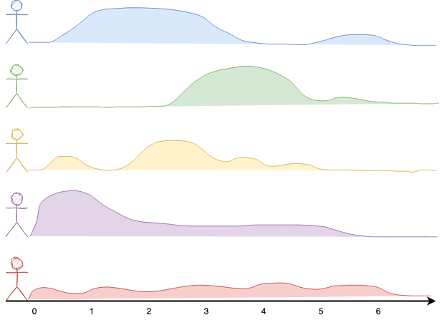
Survival analysis
What? Predict the distribution of an event taking place over time.
Why? Researchers (and clinicians) often conflate regression & classification with survival analysis. But diagnosis/prognosis is more complex.
When there is censoring in the data. E.g. finance, economics, healthcare, engineering.
Notes:
We’ve been discussing AI, healthcare and decision making but haven’t talked about any models.
Common problem across research, likely caused because of the gap between theorists and others.
Poor accessibility to relevant research -> modellers often repurpose models and code into new areas, even when it doesn’t make sense.
I’m going to try and convince you to think about survival analysis, which underpins medical stats and risk prediction models.
Hopefully can highlight why not engaging could create ethical issues.
In this example, 5 people running a marathon all have a theoretical survival distribution that models when they will finish (die) the race

Slide 16
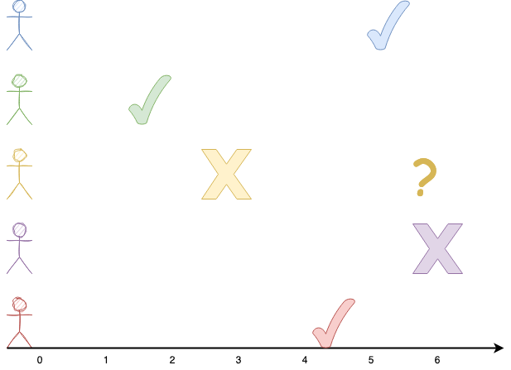
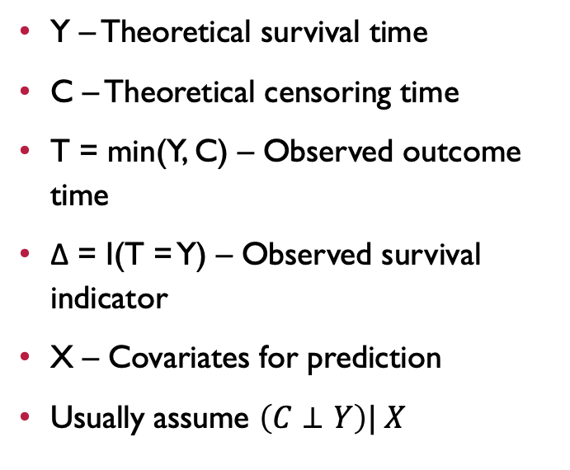
Survival analysis
Y – Theoretical survival time
C – Theoretical censoring time
T = min(Y, C) – Observed outcome time
Δ = I(T = Y) – Observed survival indicator
X – Covariates for prediction
Usually assume $\left(C⊥Y\right)| X$
Notes:
Survival analysis is unique in that it deals with censoring: the event of interest not taking place.
In this example ticks are the finishing time, crosses are censoring time, question marks are unobserved finishing time.

Slide 17
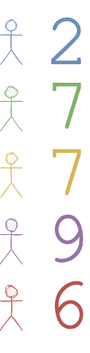
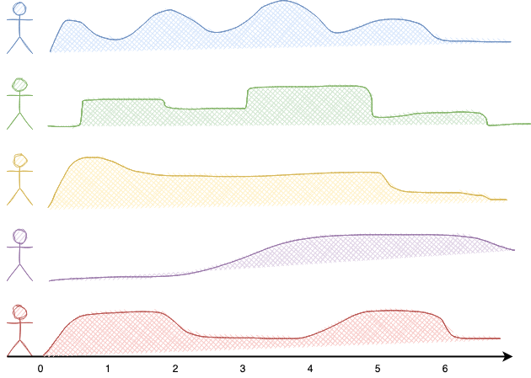
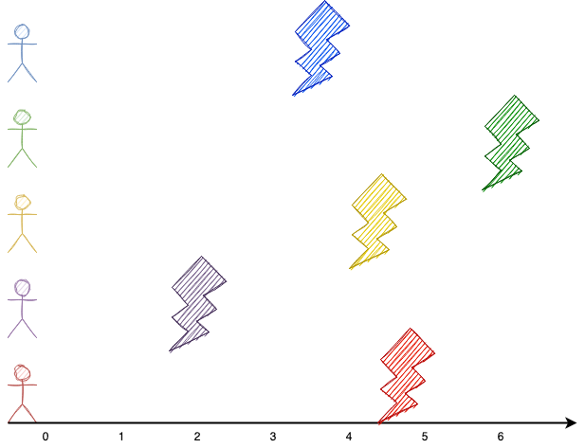
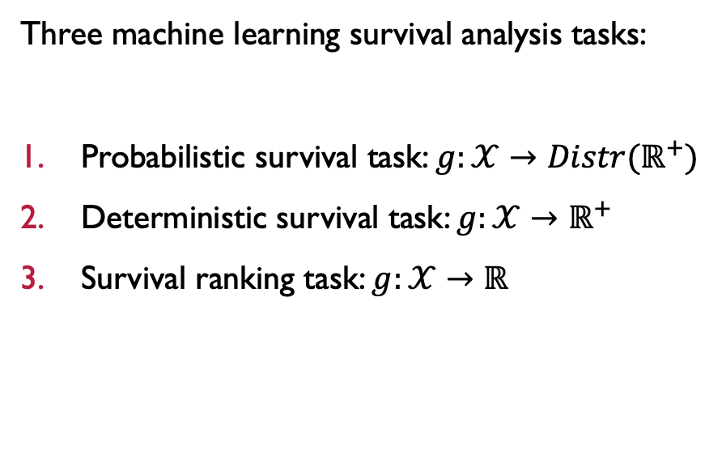
Survival analysis
Three machine learning survival analysis tasks:
Probabilistic survival task: $g:𝒳→Distr(ℝ^{+})$
Deterministic survival task: $g:𝒳→ℝ^{+}$
Survival ranking task: $g:𝒳→ℝ$
Notes:
1) SA complex because 3 *separate* prediction tasks. Predicting i) distribution; ii) time; iii) ranking.
2) Each task requires it’s own measures and is limited by its own assumptions and possible predictions
3) Many assumptions, e.g. independence of the censoring and survival event, rarely true in practice
4) Field under-researched which means only in the past year have papers been published about how to comprehensively validate complex ML models
5) Less than 5 fairness and bias papers
6) Despite this, SA used in medicine, finance, economics, engineering, public health decision making, and many more areas.
* This is unethical. More theory -> applications & code -> better quality predictions (financial & ethical gains)
* Researchers think there isn't funding for theory but there is...

Slide 18
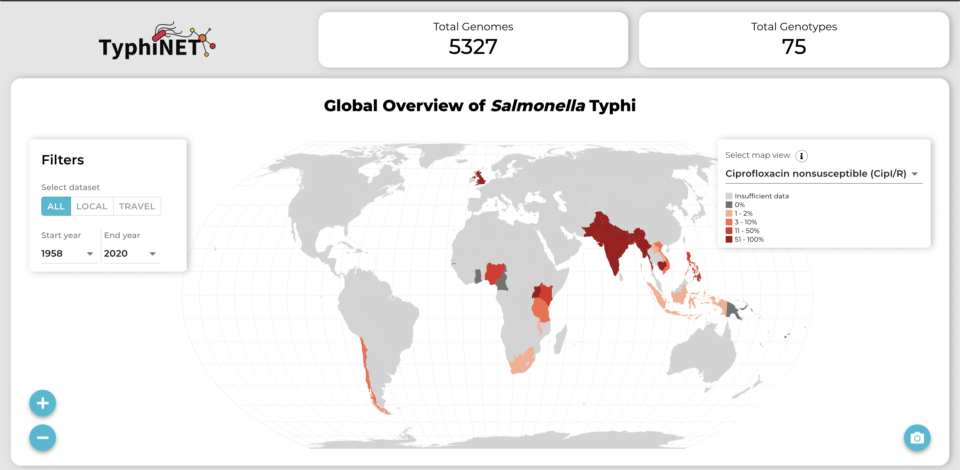
Wellcome Funded Projects
TyphiNET
Sci-ML
OpenSAFELY
Trust in Algorithmic Decision Making
MIT Foundations of AI
Bias in EHR data
Data driven checklists
https://typhinet.herokuapp.com/
Notes:
The Wellcome Trust are 4th wealthiest charity in the world with ~£35B to spend on scientific research. We care about foundational projects focusing on theory behind ethical issues we're discussing
TyphiNET: making data more accessible to policymakers
SciML: Julia to improve efficiency of ODEs for improve clinicial decision making
OpenSAFELY: fast & secure TRE for sharing C19 data
Trust: Tools to evaluate efficacy of AI accountability
MIT: Neural-encryption federated ML
Bias in EHR data: Call to debias & create new datasets by leveraging massive community of ML researchers
Data driven checklists: Novel form of decision trees to directly benefit explainability for clinicians

Slide 19
DISCUSSION
Should AI be used for public health decision making?

Slide 20
Explainability
Model validation
Visualisation
Forecasting and predictions
Risk and uncertainty
Limits of AI
Notes:
* Now we move onto explainability, again I’ll start with an overview to explainability itself and then the subtopics

Slide 21
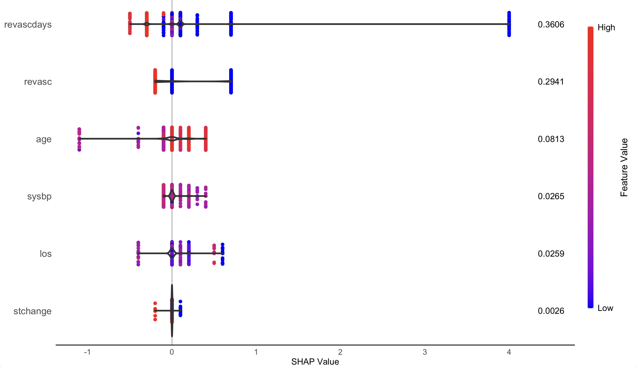
explainabilitY
Notes:
Defining explainability is surprisingly difficult, to me it is subjective, does anyone here have a good answer?
Some people call data science ‘the wild west’. We don’t have rules governing us, it’s very easy to create a model you can’t explain
Explainability may include: being able to communicate an algorithm, understanding how a model was trained and why, explaining future performance, explaining outputs and predictions, explaining what the model does and doesn’t tell us, or many other things
Today we focus on a small subset…

Slide 22
Explainability
Visualisation
Forecasting and predictions
Model validation
Risk and uncertainty
Limits of AI
Can you communicate results?
Implications and limitations
Does your model generalize?
Communicating what you don’t know
When is ML a bad idea?
Notes:
We'll focus on explainability around PH and how you explain models to policymakers and public.
We start with viz which is common across all models, visualization falls into the more general field of communication.
Under this is also understanding your own liability and the implications we make when discussing forecasting and predictions.
Once we’ve covered those differences we’ll focus entirely on ML and first look at how to validate models, as without this explainability is meaningless
Then we segue into risk and uncertainty
And finally we’ll put this together in another summary about the limits of AI

Slide 23
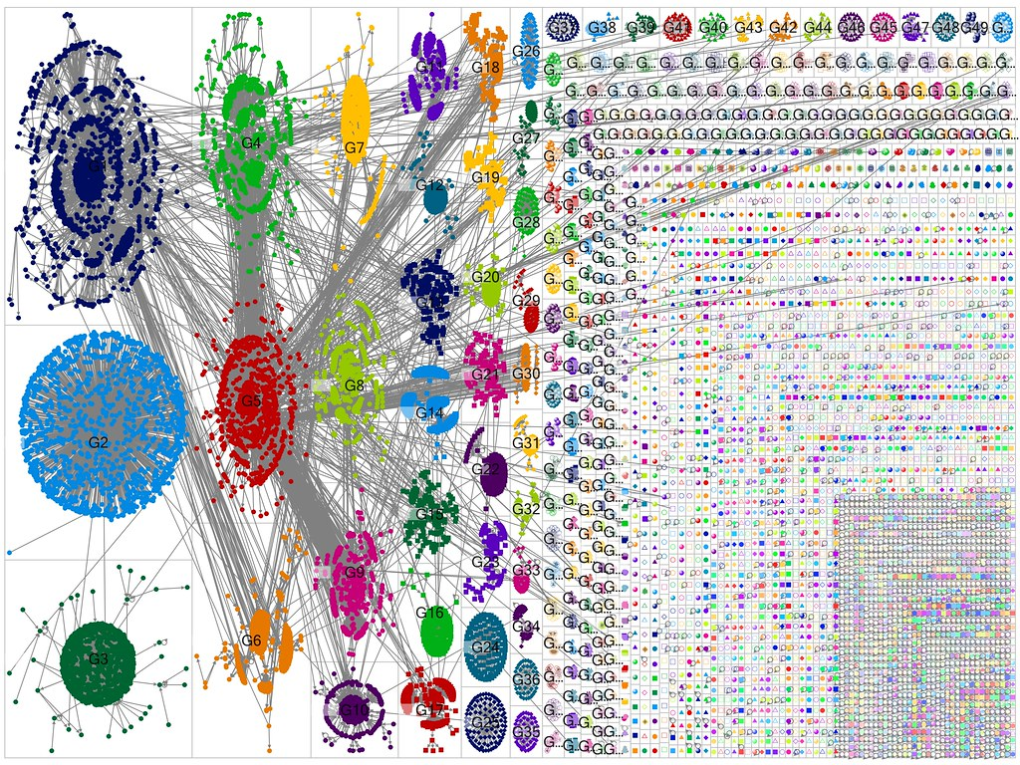
Visualisation
What story do you want to tell?
What story will be told?
How will you story be retold?
This Photo by Unknown Author is licensed under CC BY
Notes:
Starting at the very beginning. How do you communicate modelling with visualisations? Visualisation is about storytelling, to reviewers, academics, clinicians, policymakers, citizens…
Visualisation is subjective. Like p-hacking, viz can be manipulated easily to draw *any* insights.
An ethical researcher will pre-plan visualisations and be open when a viz contradicts your desired message
Variable selection, model weights, predictions, subgroup analysis, calibration, uncertainty, …
Ultimately it’s about telling a story, what do you want to convey? Looking at a few examples…

Slide 24
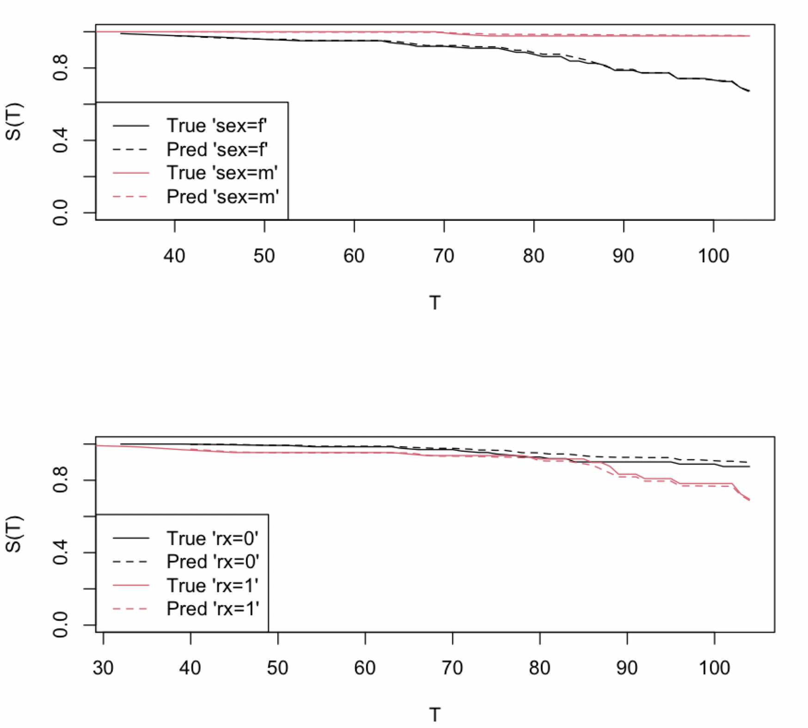
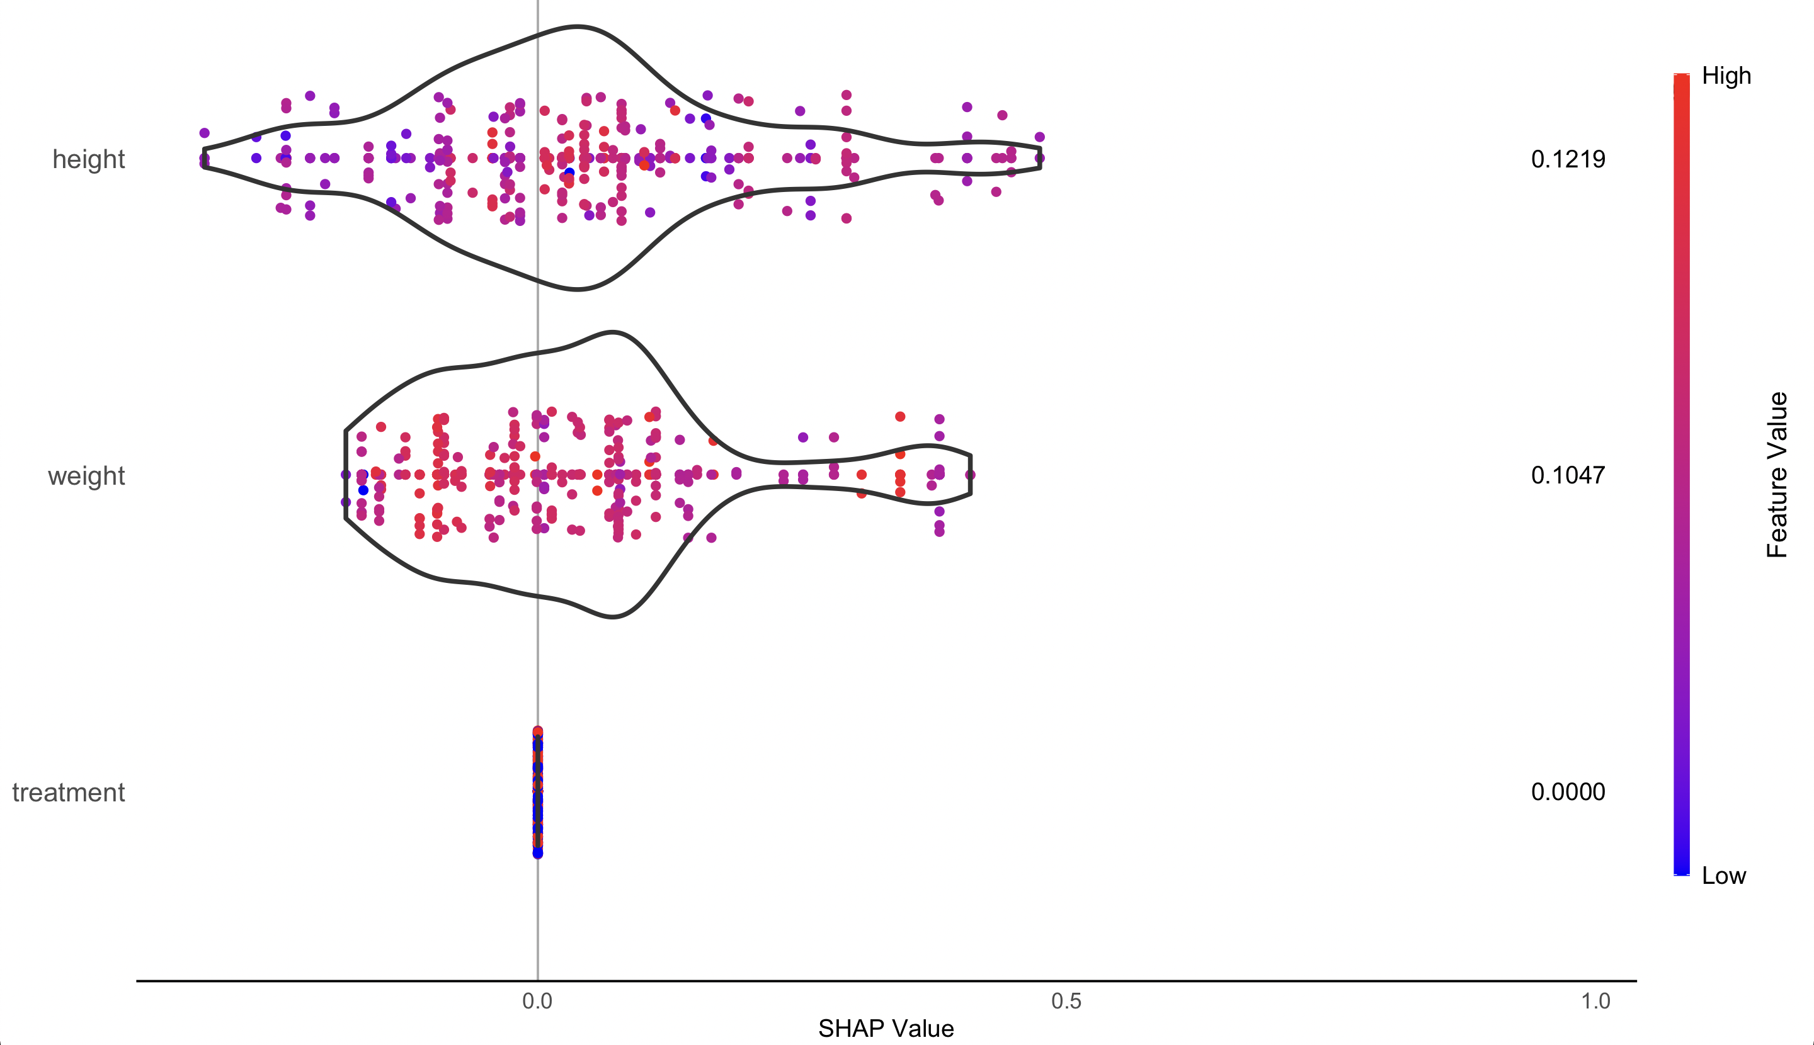
Visualisation
Notes:
1) SHAPs for feature importance on simulated data. Explainability method to tell us about feature importance and contribution to scores. Here we see Trt actually makes no difference.
2) We see our model is well-calibrated in train/test split. We also see sex makes a noticeable difference to outcome whereas treatment doesn’t.
3) More interesting is actual covid data. How do you all interpret this? Shout-out findings. I can see 2 contrary interpretations. For & against lockdowns
Visualisation is the same whether interest in complex ML or a simple linear regression. It becomes increasingly important when we start to think about how our visualisations inform policy & what our liability is as a researcher. Therefore we’re going to now think about the difference between 2 similar terms.

Slide 25
Forecasting vs Predictions
Forecasts | Predictions
Result of epidemiological modelling | Result of machine learning/statistical modelling
Model validated by visualisation fit to past data | Model validated with performance metrics
No claims made about future performance or generalisation | Claims made about expected future performance and generalisation
A consequence of inferring parameters about mathematical models | Primary outcome of supervised learning models with tuned parameters
Almost always generated for a wide range of scenarios, usually at a global level | Predictions made at an 'individual' level
Generated with credible intervals, often at 95% | Usually only point estimates predicted
Notes:
V important not to overlook difference between forecasts and predictions – despite not being able to find good definitions online.
Certain guarantees are implied in ML predictions whereas epi modelling does not make these.
Uncertainty is also at the fore of forecasting whereas it is often ignored in prediction. Forecasts are generally limited at a ‘group’/global and not individual level, whereas predictions are ’personalised
It’s important not to assume an ML prediction is ‘right’ even if well-validated – this is what we’ll focus on for the rest of the section
But first here’s an example of why being precise w. terminology is crucial

Slide 26
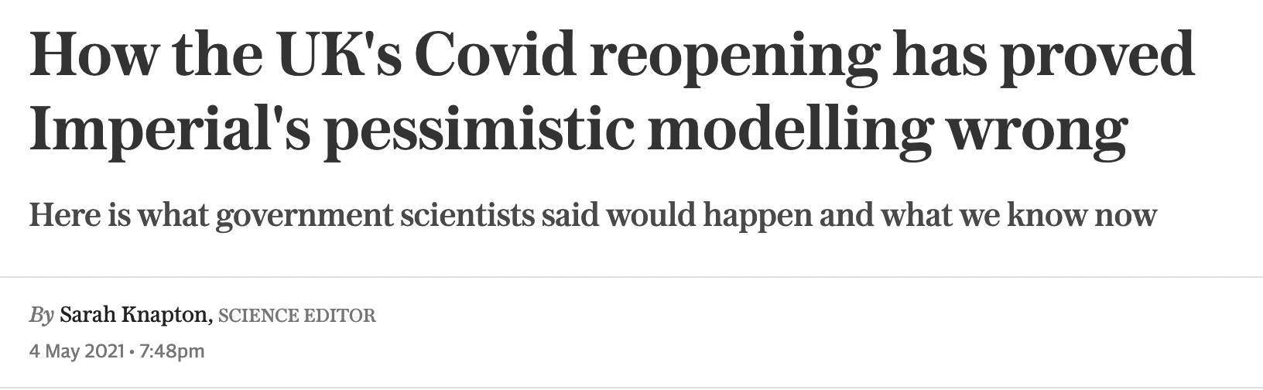
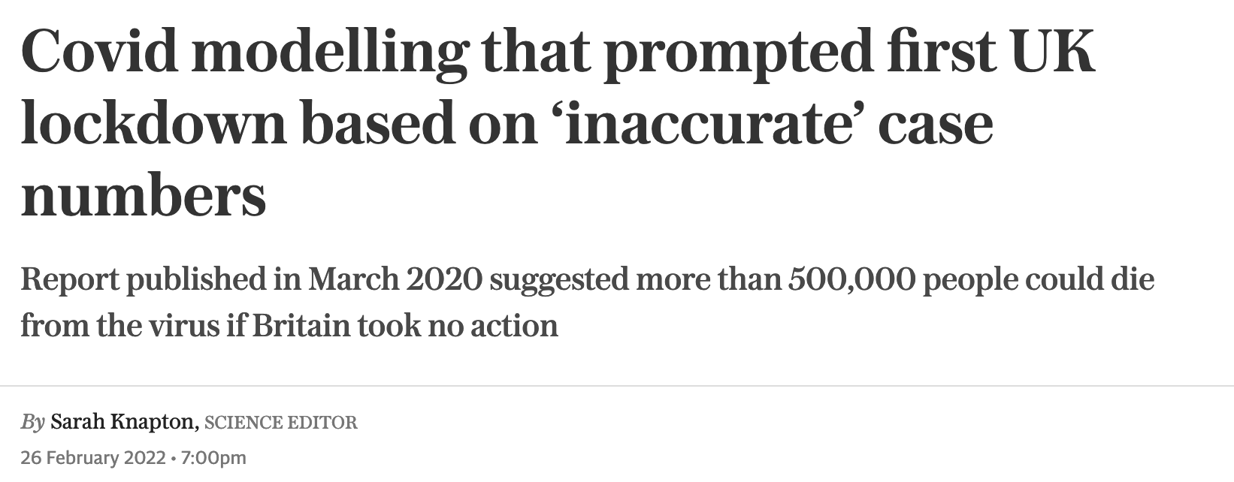
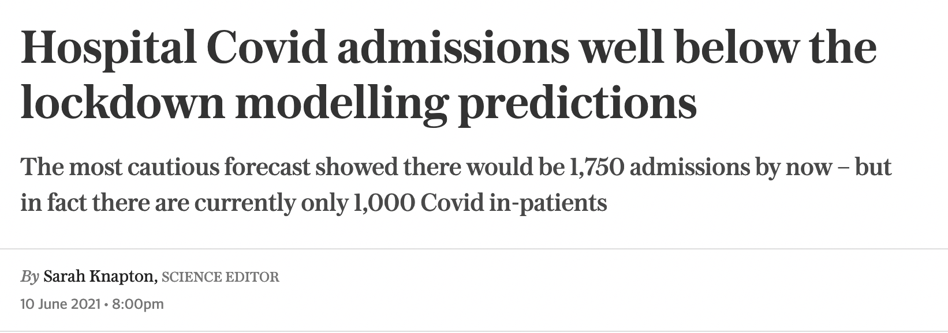
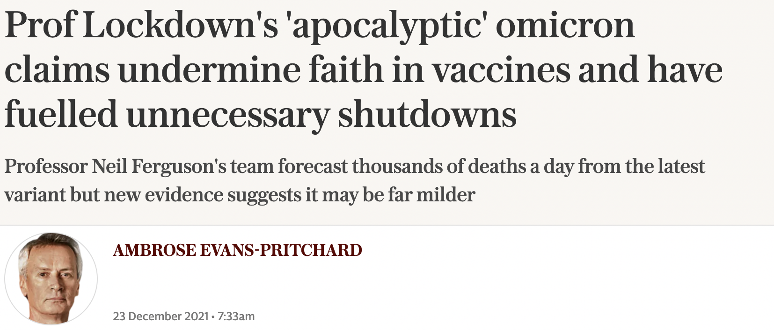
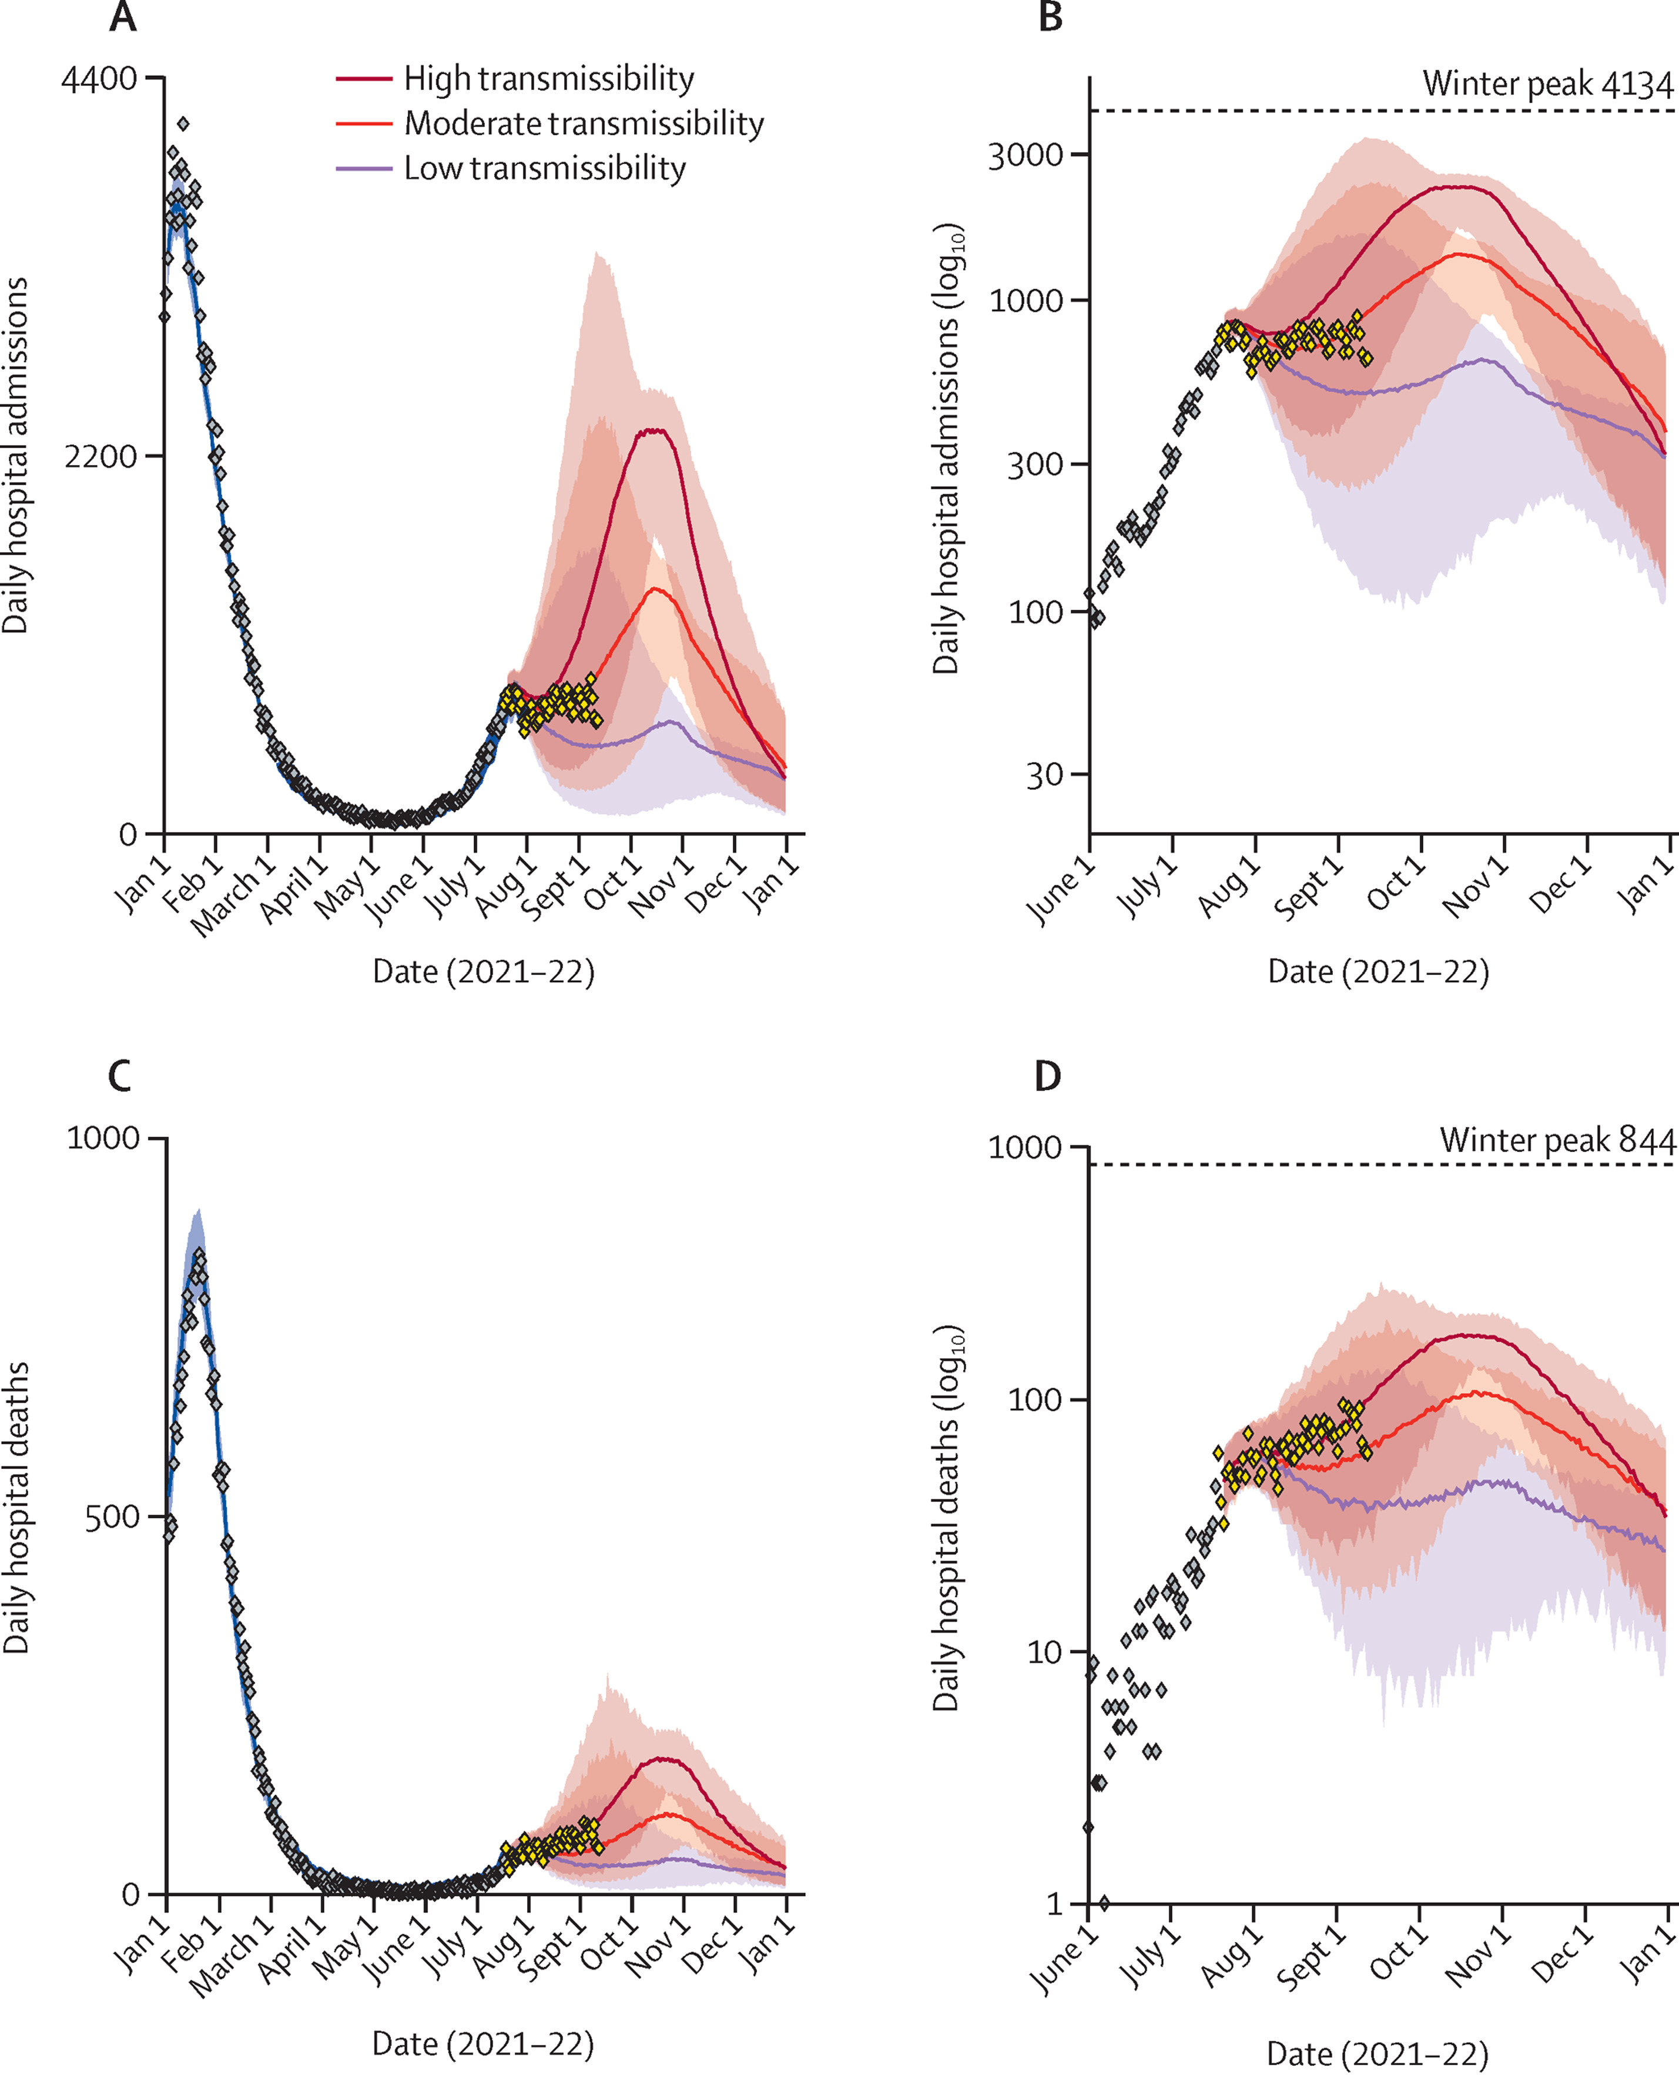
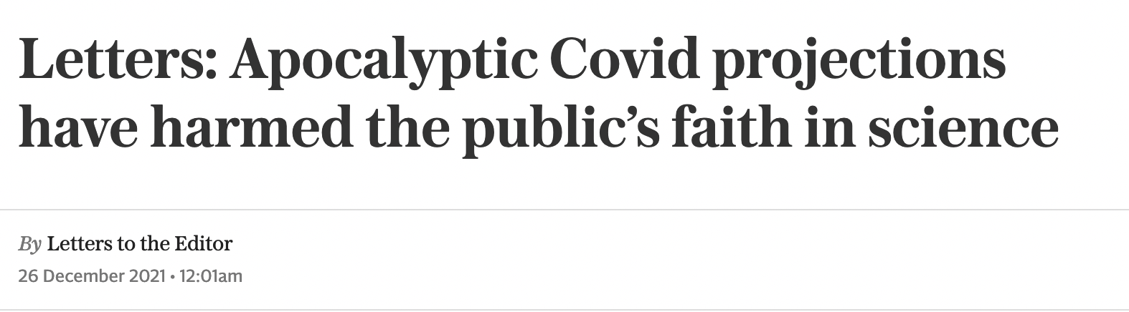
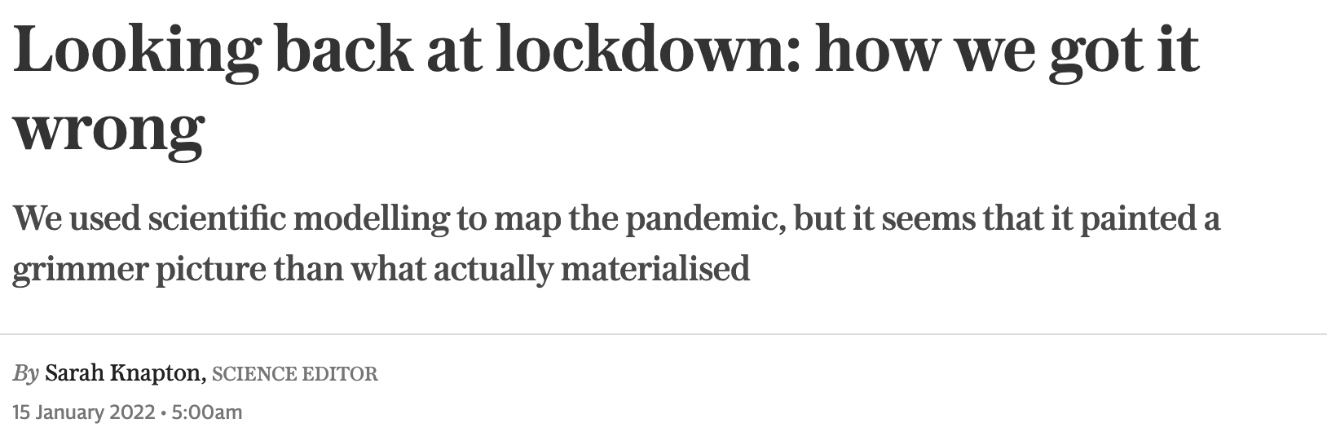
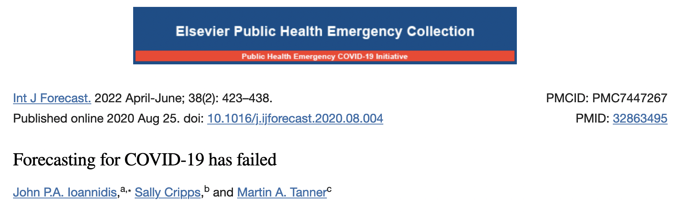
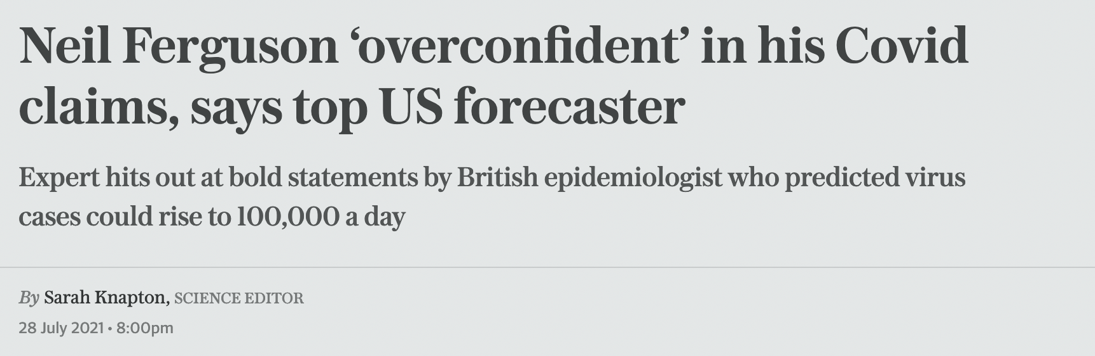
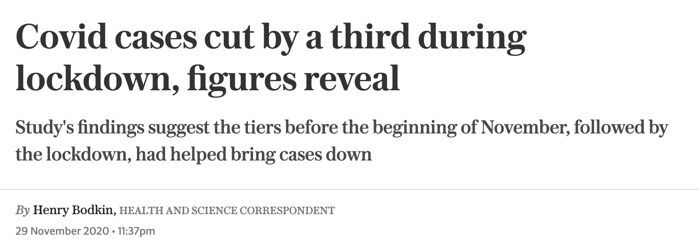
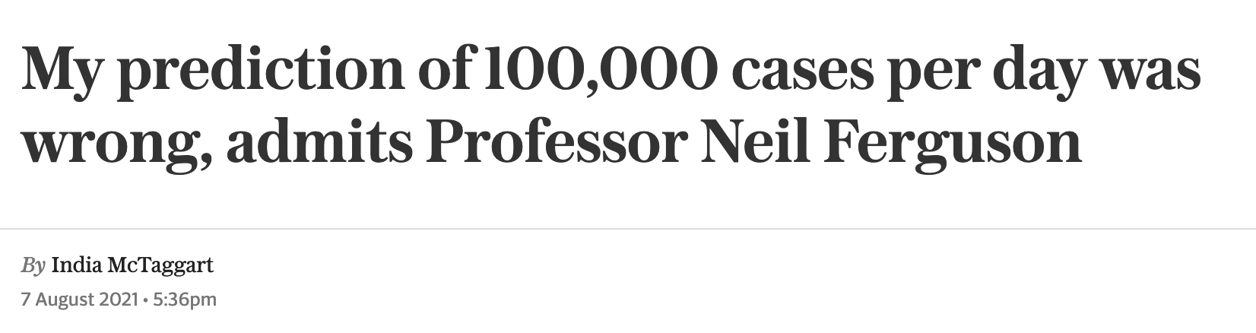
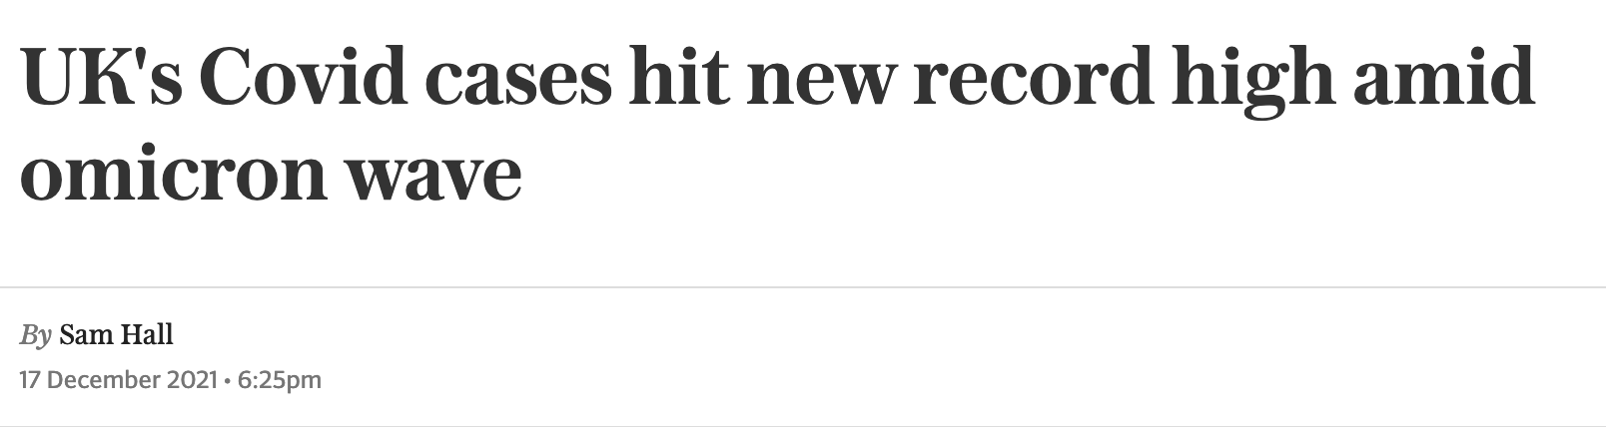
Forecasting vs predictions
Month | Scenarios | Range | Truth
Feb | 9 / 20 | 27,500 – 230,000 | 94,000 (58,000 – 148,000)
Mar | 0 / 14 | 800 – 52,000 | 40,000 (30,000 – 50,000)
May | 1 / 13 | 4,000 – 276,000 | 31,000 (20,000 – 46,000)
Jun | 30 / 76 | 400 – 241,000 | 58,000 (50,000 – 66,000)
Jul | 8 / 21 | 4,500 – 132,300 | 76,000 (50,000- 97,000)
Notes:
Take for example our forecast cumulative number of deaths between roughly June 2021 and June 2022
Col 1 is month of paper; 2 is number of scenarios with 57K cum deaths; 3 is range over all scenarios; 4 is forecast under ‘true’ scenario
True cumulative deaths between now and Jan ‘21 is roughly 57,000
Despite this, it will likely be deliberately overlooked when a story needs to be told

Slide 27
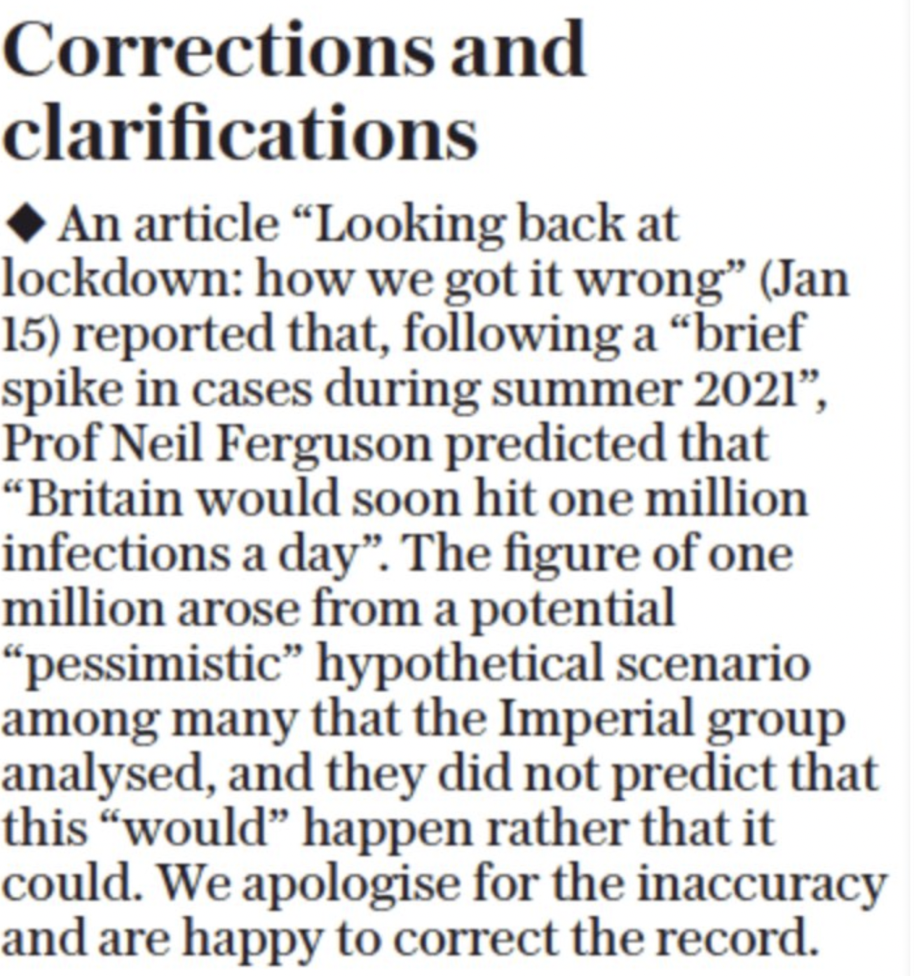
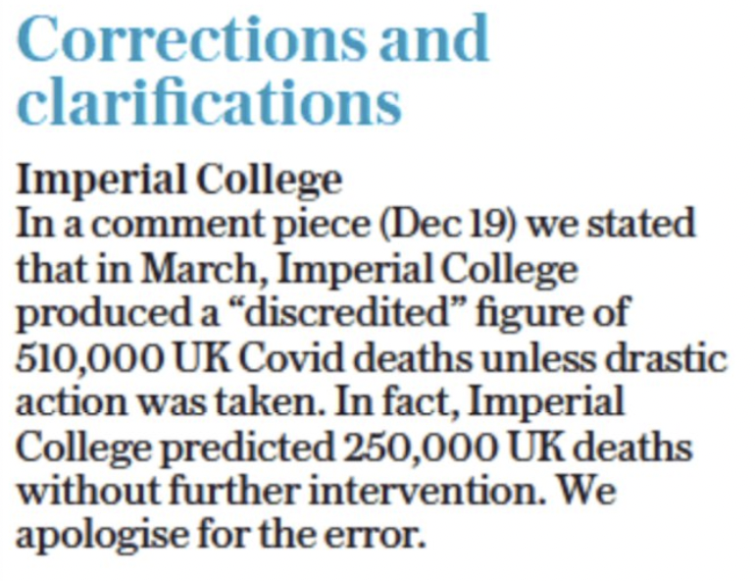
Forecasting vs predictions
Notes:
Luckily we had a great media team - 19 corrections made to-date
But the point is that we were never in trouble because we always made very clear in every report every uncertainty & limitation – this is easier in forecasting than predicting…
So now we’ll look at how to explain a ML model by first understanding if the model is even ‘good’

Slide 28
Model Validation
For
Performance guarantees
Ethical
Parsimony principle
Multiple metrics
Generalisation error
Scientific method
Hypothesis testing
Model drift
Against
Models don't need separate validation
Automation
Ensembling
Tune for performance metrics
Minimise fairness metrics
Never precise enough
All models are wrong
Notes:
* Model validation is the process of understanding if a ML (or any other) model is actually ‘good’. Despite this there are arguments against model validation. However you look at it, it is morally necessary.
* Model validation is very hard but again necessary otherwise we cannot explain anything, we’ll see an example of this soon.
* Arguments against include ensembling/superlearners, but is this ethical? Similarly we could just tune for optimization of metrics and/or fairness but recent research demonstrates this doesn’t actually work, e.g. optimisation of fairness metrics disadvantages the advantaged group but doesn’t advantage the disadvantaged group. [Zietlow et al., 2022]

Slide 29
Model Validation
n models
= 1
> 1
Single
Multiple
Add baseline, n > 1
Informative baselines
Correlated
Uncorrelated
ANOVA
Friedman-Nemenyi
Domains
Metrics
Calibration
Discrimination
Scoring rules
Properness
Interpretability
t-test
Evaluating
Learning algorithm
Trained predictor
Conservative Z
Fairness
Notes:
* This diagram demonstrates the complexities of model validation. AutoML makes validation look easy but actually it is the hardest part of any ML deployment pipeline (but often overlooked).
* As ethical researchers we must know how to validate a model and how to interpret the results of model evaluation. Next slide gives an example.

Slide 30
Model Validation
S(T)
Brier score = 0.002
Baseline Brier score = 0.001
0.5
0
10
20
T (days)
Notes:
* Can someone tell a story based on this graph?
* Now what happens if we predict the distribution?
* What about CIs? What about standard errors?
* Is this Brier score good? But now consider the baseline.
* We’ve implicitly encoded a lot of uncertainty here. Combining uncertainty w. validation is an underresearched area because people don’t treat uncertainty holistically. So let’s chat about that briefly.

Slide 31
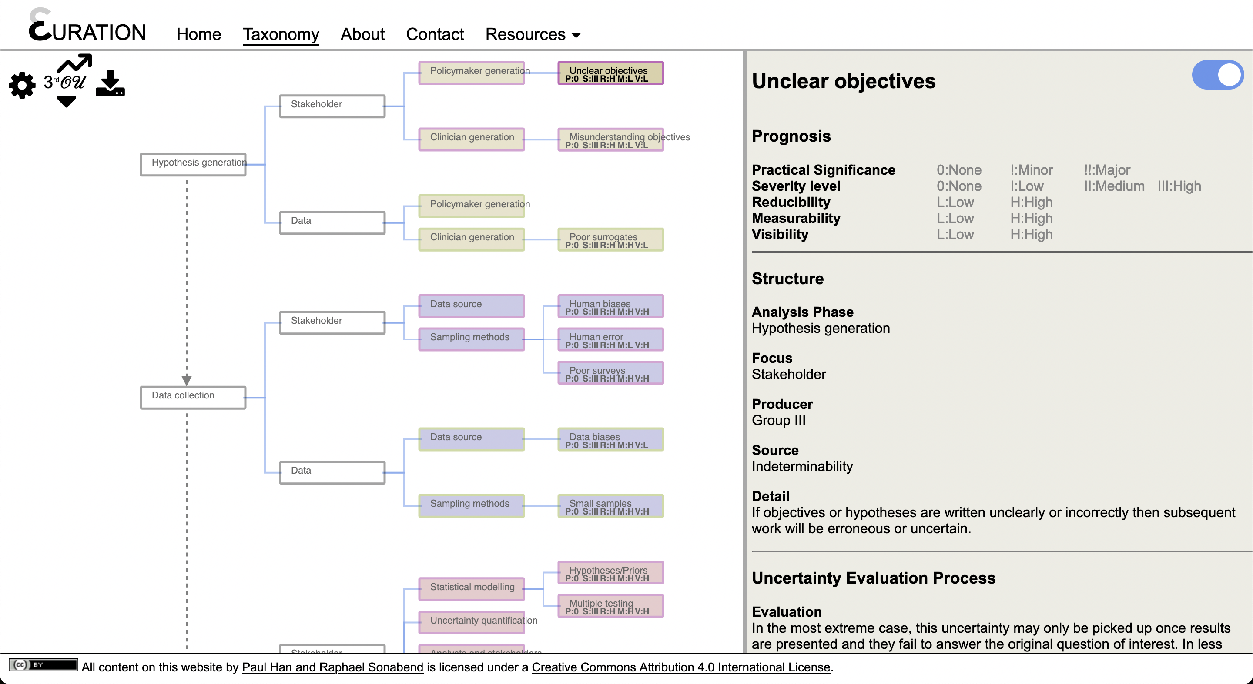
Risk and Uncertainty
Acknowledge
Communicate
Embrace
Notes:
Big lesson from C19 was need to embrace uncertainty early on. Saw earlier how uncertainty was ignored by UK media, however it’s still important to try as it affects the public and in particular conspiracy theorists.
At the very least uncertainty must be acknowledged. Humbles researchers and reduces liability and over-confidence. Acknowledgment: “our research is not perfect” or “there is uncertainty in our findings”.
Whenver possible, communicate uncertainty to be transparent about level of uncertainty. Communication may take the form of credibility/confidence intervals, gist representation (Reyna), visualizations (e.g. icons and curve), or transparent statements about limitation.
Finally embrace uncertainty yourself. Not just uncertainty in your own work but across the entire modelling pipeline for all orders of uncertainty…

Slide 32
Risk and Uncertainty
$$Orders of Uncertainty (𝒪𝒰)$$
𝑂𝑟𝑑𝑒𝑟𝑠 𝑜𝑓 𝑈𝑛𝑐𝑒𝑟𝑡𝑎𝑖𝑛𝑡𝑦 (𝒪𝒰)
$0𝒪𝒰$ (Certainty) Absolute truth. Impossible to attain.
0𝒪𝒰 (Certainty) Absolute truth. Impossible to attain.
$1𝒪𝒰$ (Risk) Probability of a given event. Implicit acknowledgement of imperfect knowledge.
1𝒪𝒰 (Risk) Probability of a given event. Implicit acknowledgement of imperfect knowledge.
$2𝒪𝒰$ (Ambiguity) Estimates of risk of probability. Acknowledgement of lack of reliability. Conscious awareness of uncertainty.
2𝒪𝒰 (Ambiguity) Estimates of risk of probability. Acknowledgement of lack of reliability. Conscious awareness of uncertainty.
$3𝒪𝒰$ (Meta-uncertainty) Estimates of ambiguity. Transcendent level of awareness & ability to engage and interact with uncertainty.
3𝒪𝒰 (Meta-uncertainty) Estimates of ambiguity. Transcendent level of awareness & ability to engage and interact with uncertainty.
Notes:
* Working with US researcher to build interactive uncertainty taxonomy, built on orders of uncertainty.
* 2 decades research of uncertainty classification routinely focuses on particular fields but doesn’t take a holistic view. Unethical...
1) A clinician uses model to decide what treatment to give to a cancer patient. What if uncertainty in data collection leads to undetected model bias?
2) Policymaker communicates results from a scientific study to the general public and they are well-informed and communicate well. May overlook public misunderstanding without good feedback.
* Many other examples of this. Which is why we must think about uncertainty at all stages in the modelling pipeline and not just our own.
* This leads to the final topic of explainability we’ll look at. Which is the Limits of AI.

Slide 33

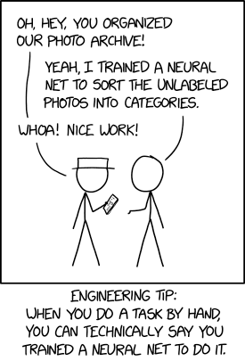
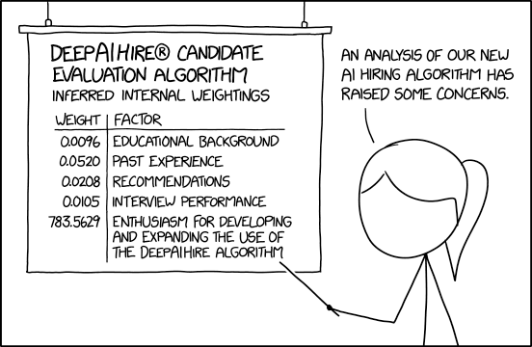
Limits of AI
Explainability.
Sustainability.
AI is limited by data.
AI is limited by producers and consumers.
All models are wrong (but some are useful).
Can we guarantee generalization?
Performance deteriorates over time, even if the model itself does not.
Notes:
Doesn’t matter how much uncertainty you capture/communicate or how explainable your model is, AI fundamentally limited.
Would you trust an algorithm to make life & death decisions for your relatives? Do we trust a black-box neural net? Do we trust the people that created them? Predictions can be systematically racist/biased, or simply false.
These XKCD comics highlight very real and common issues: people use AI just because it sounds good or because it’s commercially/financially useful; people also use AI assuming it will ‘work’ even when the data is bad. These fundamental limitations cannot be ignored. To lead us into the discussion: when would you feel comfortable deploying AI?

Slide 34
DISCUSSION
When would you feel comfortable deploying AI?

Slide 35
Sustainability
Open source
Community building
Environmental
Access & maintenance
Notes:
Finally sustainability, again overview to topic and then subtopics

Slide 36
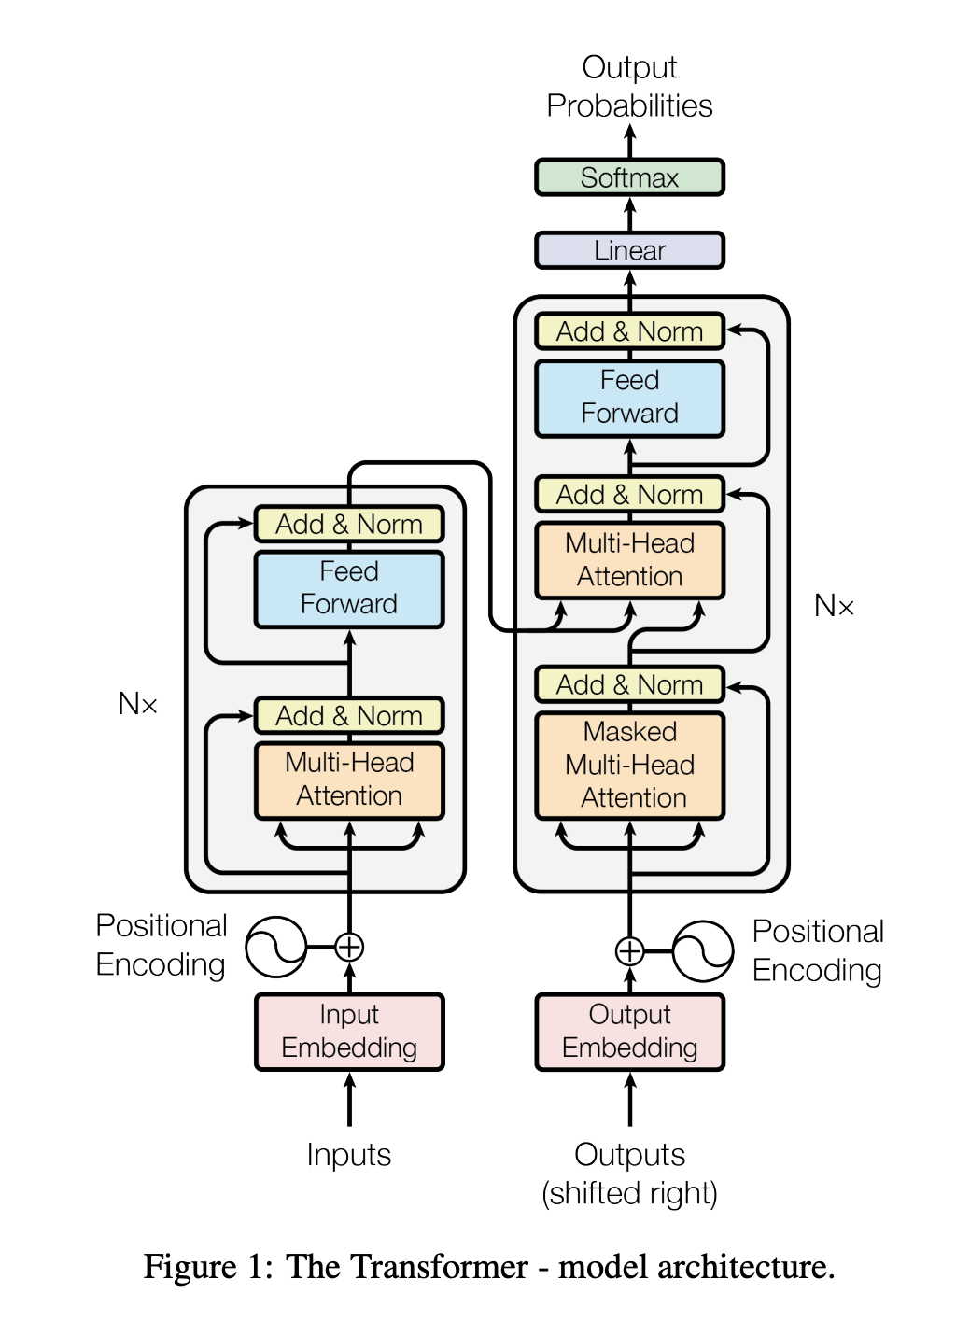
sustainability
Figure from Vaswani et al. (2017). Attention is all you need. Advances in Neural Information Processing Systems 30 (NIPS 2017). https://papers.nips.cc/paper/2017/hash/3f5ee243547dee91fbd053c1c4a845aa-Abstract.html
Notes:
Sustainability may cover a lot of areas but as we are focused on deployment primarily I’m going to talk about longevity of your code and research and ensuring your hard work isn’t wasted.

Slide 37
Sustainability
Open source
Community building
Access & maintenance
Environmental
Licencing and preservation
Utilising the power of community
Open does not always mean open
Protecting our planet!
Notes:
* OS and why it matters. We’ll tackle the complex issue of licensing and then what it means to preserve your work.
* Then we’ll move on to how OS leads to community participations and how this can be leveraged for your own work.
* When open source does not mean open access & what this means in practice.
* Finally we’ll touch briefly on environmental sustainability and what this may mean in practice.

Slide 38
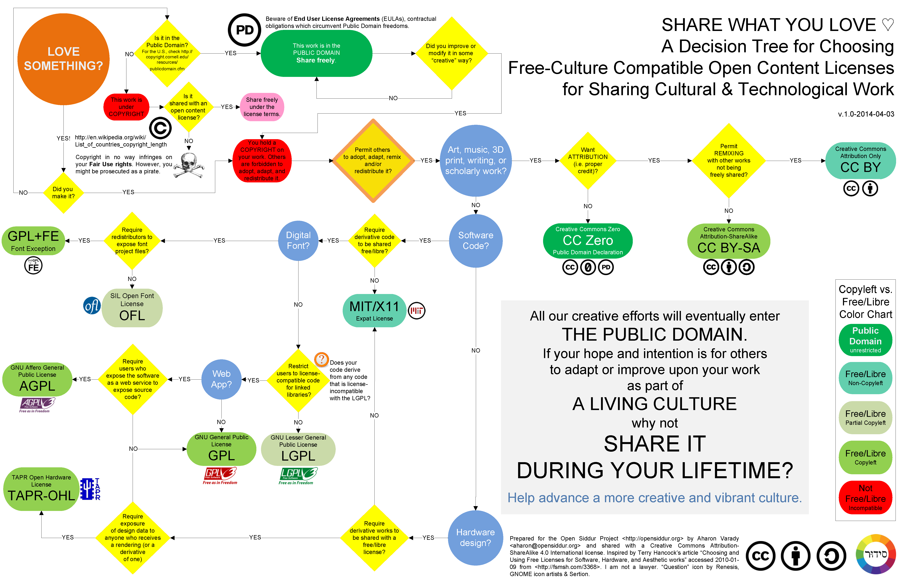
Open Source
Data science depends on open source.
Always consider permissive, and copyleft licensing for all work.
Be aware of abandonware. How does this affect your work now and in the future?
Leverage open-source to preserve your work after you’ve left.
By Aharon Varady - Own work, CC BY-SA 3.0, https://commons.wikimedia.org/w/index.php?curid=30077847
Notes:
Big movement towards OS, even in industry & big pharma.
Important to be aware of complex licensing issues. My opinion is to use permissive (e.g. MIT, Apache, CC BY) licenses as these place no restrictions on future derivatives and won’t scare off other developers
Limitations of OS include poor code quality & abandonware. Depending on software that doesn’t work or is unsustainable will affect your project. No good answer but to be aware.
OS allows your work to exist after you’ve moved onto other projects. Other people can contribute to your projects and hopefully make them even better.
Humbling to not work for yourself but for a community. I like thinking about how my code is currently preserved…

Slide 39
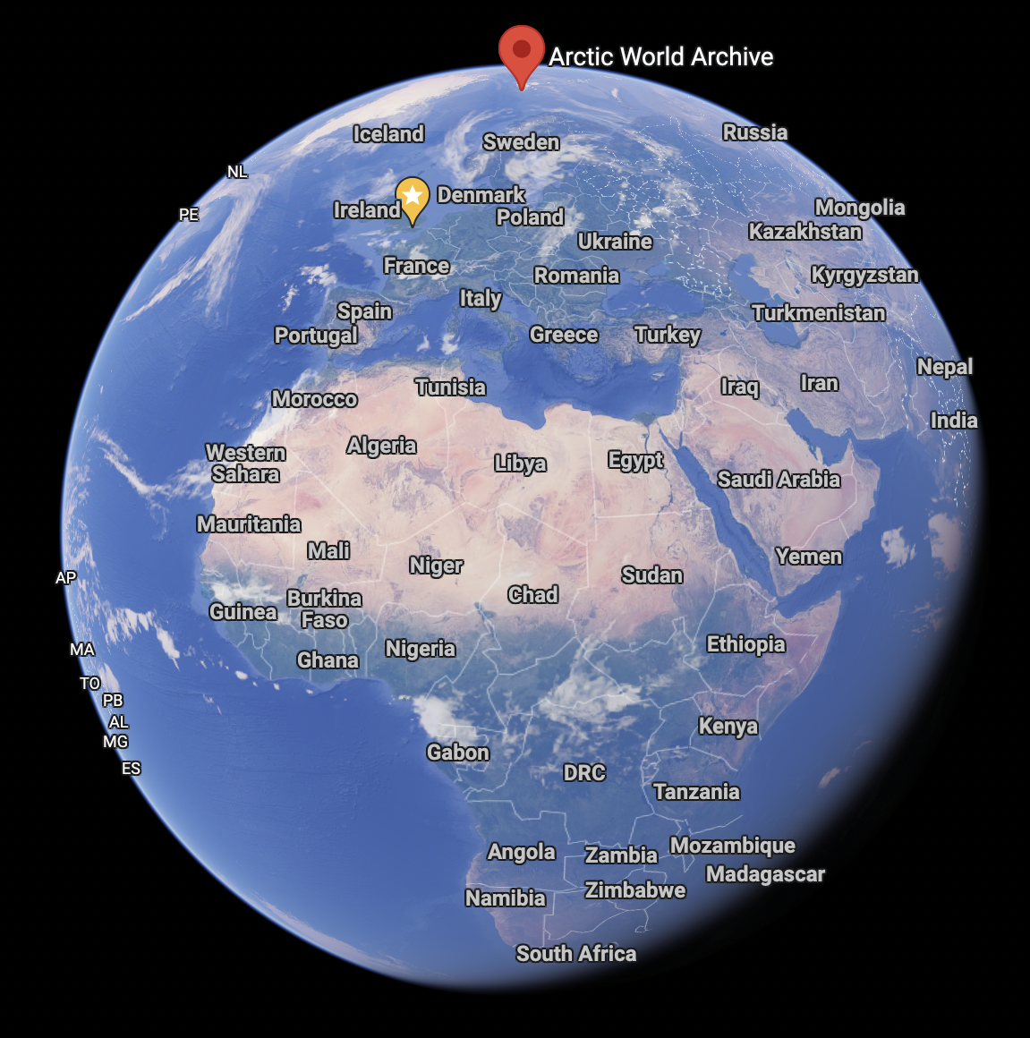

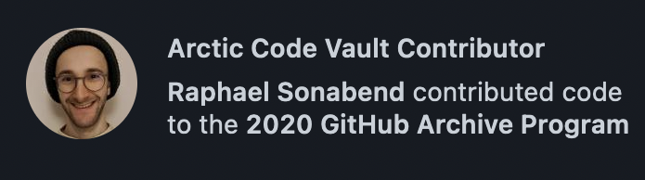

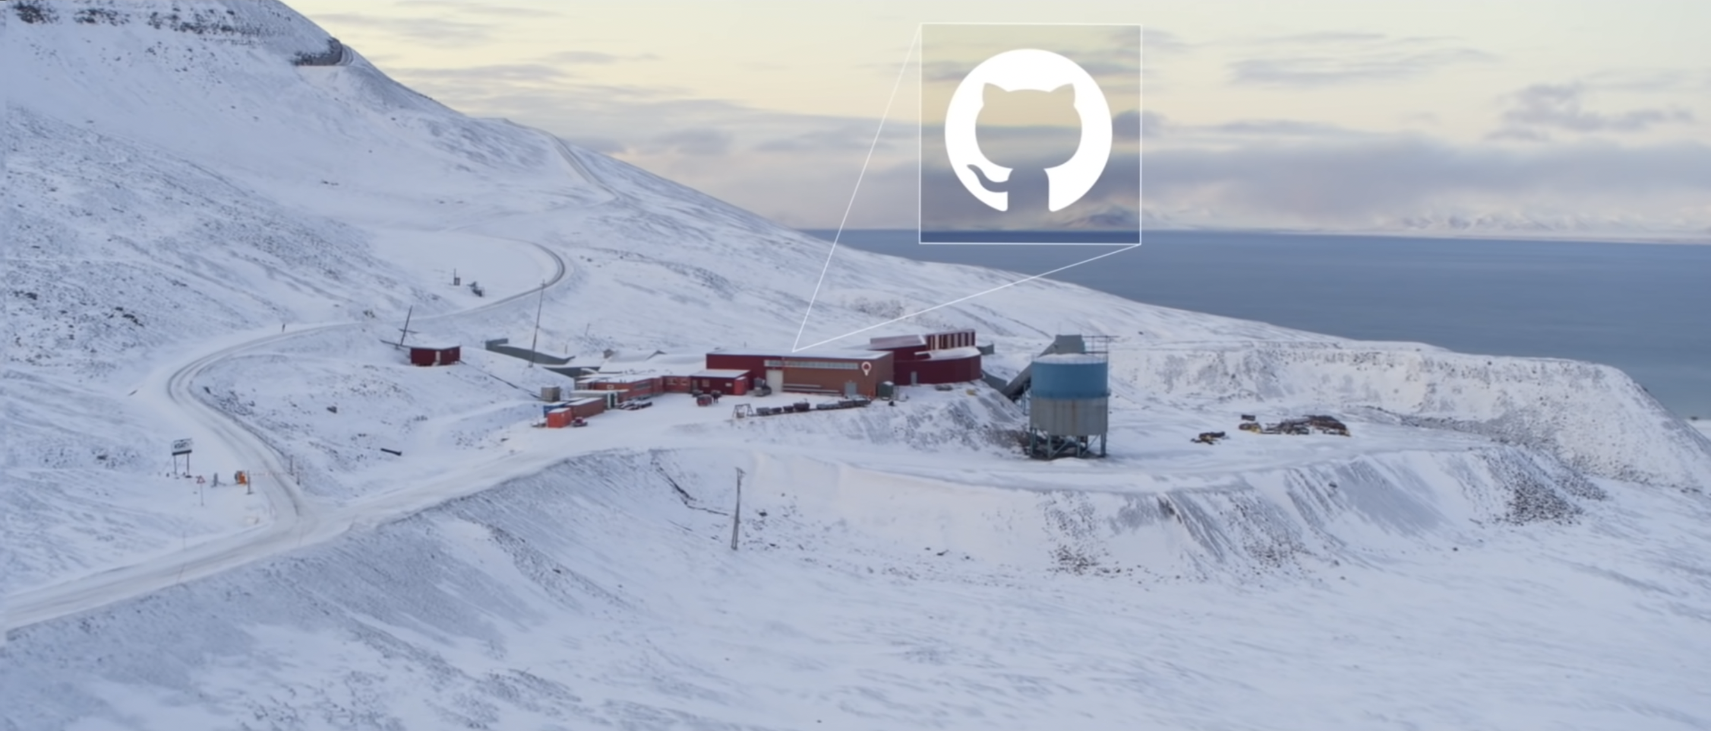
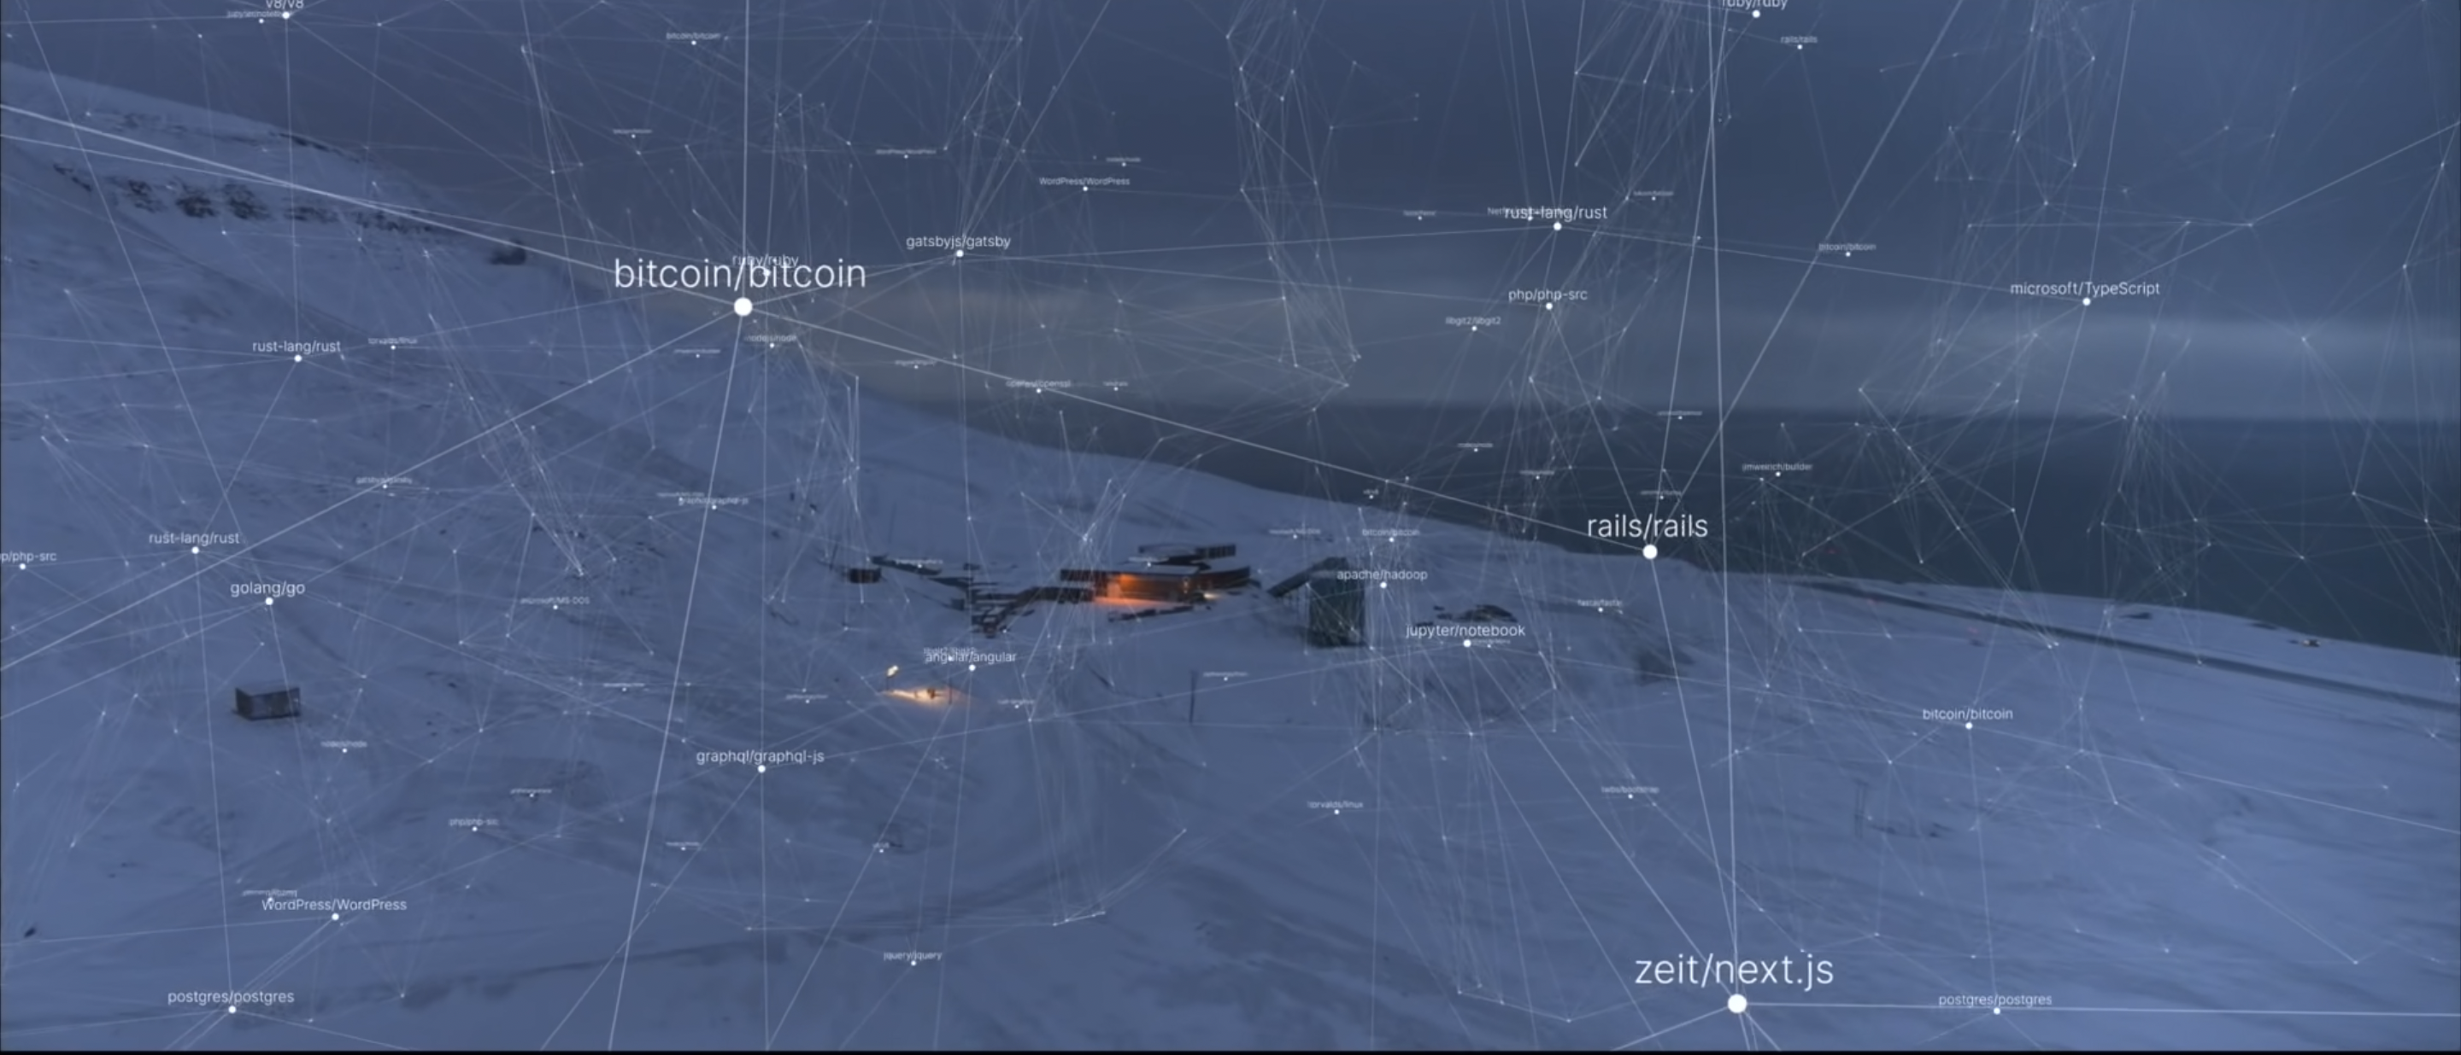
Open Source
Notes:
At the top of the world in Norway, a snapshot of all public GH repos has been archived in a physical format that should last 1,000 years.
Just next to the the Global Seed Vault sits millions (billions?) of lines of open source code.
It’s pretty cool to think about!
My code does not exist alone but is part of a community…

Slide 40
Community building
Build community early for co-design. Engage interns.
Approach and interact with other developers.
Technical ability < Community management.
Permissive > copyleft.
Use free tools like GitHub discussions and issues.
Be open about your limitations.
Package | Stars | Downloads | Forks | Code
distr6 | 93 | 151K | 18 | 24,884
survivalmodels | 26 | 22K | 9 | 2,487
param6 | 8 | 29K | 3 | 2,698
ooplah | 2 | 25K | 0 | 1,112
set6 | 13 | 126K | 0 | 5,834
dictionar6 | 0 | 26K | 0 | 971
mlr3benchmark | 8 | 7975 | 0 | 1,344
mlr3proba | 69 | 82K | 15 | 5,925
mlr3extralearners | 40 |  | 36 | 12,728
Notes:
Community is real driver to OS. Few key rules.
1) What's useful to community? What's your place in it? What are your aims?
2) Problem (/benefit) of OS is technical brilliance valued less than community. Best package doesn't equal popularity.
3) Remember what OS community likes/dislikes. Copyleft scares people as it limits their own outputs.
4) Great OS management software out there, use them. GitHub, SO, Gitter, Slack, Mattermost, etc.
5) OS is free, most software voluntary. Don’t be bullied by users. Be clear what you can/’t do & confident in asking users for PRs & issues. Be open about time.
I did not learn these rules early, which meant a lot of unpopular code! Don't care for PhD but think about what you value in software.

Slide 41
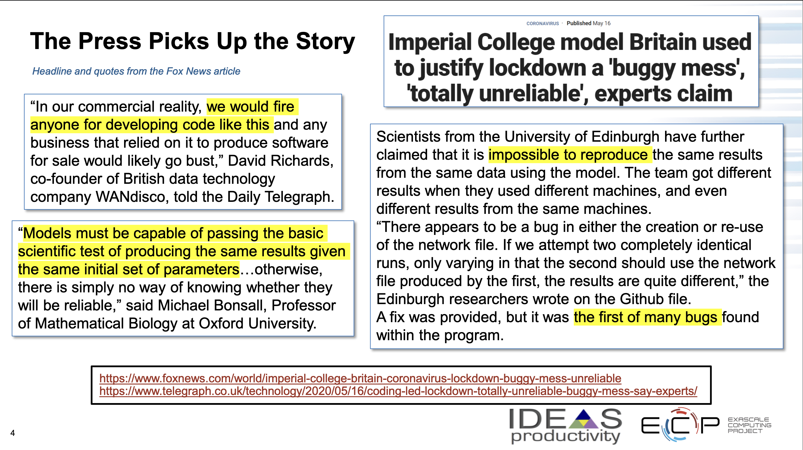
Access & Maintenance
Open-source does not guarantee open research.
Open machine learning requires:
Open-source code
Feasible computational resources
FAIR data
Well-documented code
Maintaining code is a full-time job that is vital to sustainability.
Bernholdt and Rogers. https://extremecomputingtraining.anl.gov/files/2020/08/ATPESC-2020-Track-7-Talk-10-Bernholdt-Summary.pdf
Notes:
Big ethical issue. Just because your code is open source, that does not mean your research is open.
Imperial suffered in media because code so complex no-one else could run it. Poorly documented & tested but ran fine. Issue was no-one had computational resources to run code and assumed incorrect. When people given access, verified results. That's not open.
Openness requires: OS, access to computational resources, documentation that can be understood without experts, and FAIR (findable, accessible, interoperable, resusable) data.
Today discussed research, code writing, deployment. Expense of maintaining code. Not good! Maintanence is a FT job, but often done PT. Core part of sustainability. Bug fixing, model updating, or just updating dependencies. Cannot be forgotten.

Slide 42

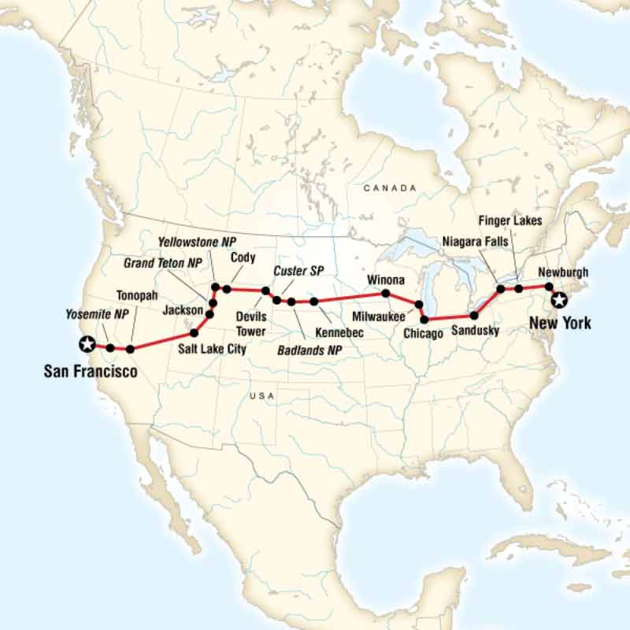
Environmental
Environmental sustainability of AI will become increasingly important going forward.
Carbon emissions from AI training will be viewed as part of industry/funder emissions. Understanding these issues and identifying how to address them will provide a competitive edge.
Notes:
V briefly with the environment. I will not provide detail here as more qualified people already taking about this
Picture left: One claim said GPT-3 training CO2e was equal to 5 American cars, another said 3 flights from San Fransisco to NYC
Note: CO2e affects funders via funded research. Identifying and acknowledging this provides a good competitive edge, same is true in industry
At Wellcome we are currently funding a large project to understand how to measure CO2e (carbon equiv) from AI, what barriers exist, and how to action our findings

Slide 43
Thank You!
Questions?

Slide 44
Cc by 4.0
Email: raphaelsonabend@gmail.com
Twitter: @RaphaelS101
GitHub: RaphaelS1
Medium: https://medium.com/@raphael_s
LinkedIn: raphael-sonabend
ResearchGate: Raphael-Sonabend
Website: https://www.raphaelsonabend.co.uk/
Jobs: https://sebastian.vollmer.ms/jobs/
Notes:
Keep in touch!

